Slide 1

Algorithms for Estimating Speech Parameters

Slide 2
Contents
Median Smoothing and Speech Processing
Speech-Background/Slience Discrimination
A Bayesian Approach to Voiced Detection
Formant Estimation

Slide 3
Median Smoothing and Speech Processing

Slide 4
Median Smoothing and Speech Processing
What is Median Smoothing?
Definition
Median smoothing is a technique used to remove outliers and reduce signal noise by replacing each data point with the median value of its neighboring points.
Advantages
Preserves edges and sharp transitions better than mean smoothing.
Effective in removing impulse noise and outliers.

Slide 5
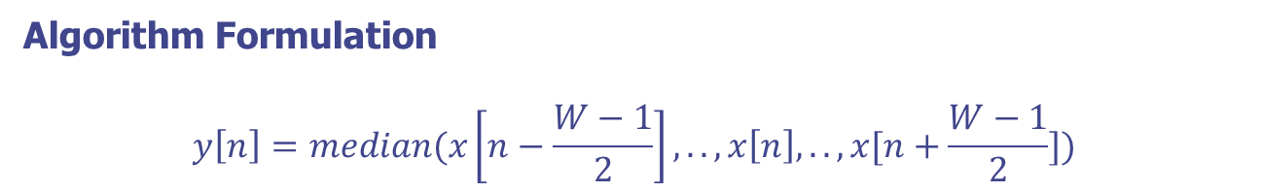
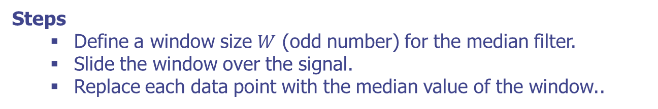
Median Smoothing and Speech Processing
Formulation of Median Smoothing
Steps
Define a window size $W$ (odd number) for the median filter.
Slide the window over the signal.
Replace each data point with the median value of the window..
Algorithm Formulation
$$y\left[n\right]=median(x\left[n−\frac{W−1}{2}\right],..,x\left[n\right],..,x[n+\frac{W−1}{2}])$$

Slide 6
Median Smoothing and Speech Processing
Explanation of Median Smoothing
Steps
Define a window size $W$ (odd number) for the median filter.
Slide the window over the signal.
Replace each data point with the median value of the window..
Algorithm Formulation
$$y\left[n\right]=median(x\left[n−\frac{W−1}{2}\right],..,x\left[n\right],..,x[n+\frac{W−1}{2}])$$

Slide 7
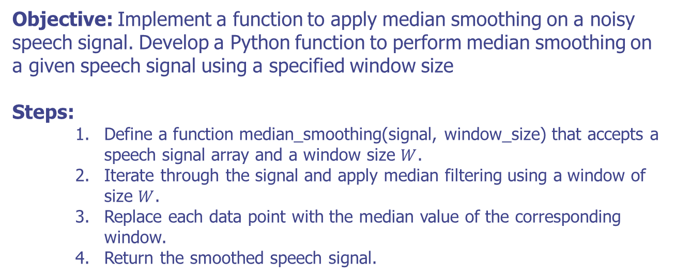
Median Smoothing and Speech Processing
Implementing Median Smoothing
Objective: Implement a function to apply median smoothing on a noisy speech signal. Develop a Python function to perform median smoothing on a given speech signal using a specified window size
Steps:
Define a function median_smoothing(signal, window_size) that accepts a speech signal array and a window size $W$.
Iterate through the signal and apply median filtering using a window of size $W$.
Replace each data point with the median value of the corresponding window.
Return the smoothed speech signal.

Slide 8
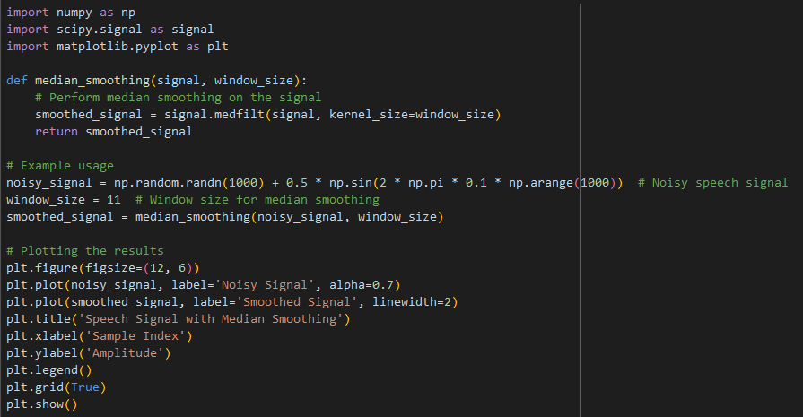
Median Smoothing and Speech Processing
Implementing Median Smoothing

Slide 9
Median Smoothing and Speech Processing
Summary
Effectiveness
Median smoothing effectively reduces noise and preserves important features in speech signals.
Application
Widely used in speech processing algorithms such as formant estimation, pitch detection, and speech enhancement.
Practical Implementation
Python provides efficient tools (scipy.signal.medfilt) for implementing median smoothing in speech processing applications.

Slide 10
Speech-Background/Slience Discrimination

Slide 11
Speech-Background/Slience Discrimination
Importance of Discrimination
Why Discriminate Speech from Background/Silence?
Signal Segmentation:
Discrimination facilitates segmenting audio signals into meaningful parts (speech vs. non-speech), aiding subsequent processing tasks.
Segmented speech allows for targeted analysis and feature extraction.
Enhanced Processing:
By focusing processing efforts on speech segments, algorithms can achieve higher accuracy in tasks like voice activity detection, speech enhancement, and speaker diarization.
Discrimination reduces computational complexity by ignoring non-speech regions.

Slide 12
Speech-Background/Slience Discrimination
Formulation of Discrimination Algorithms
Algorithm Formulation
Features Used
Discrimination algorithms often leverage various signal features, such as energy, spectral content, zero-crossing rate, and statistical properties.
These features provide valuable information for distinguishing speech from background or silence.
Thresholding
A common approach involves setting adaptive or fixed thresholds based on feature analysis.
Thresholds are applied to feature values to classify segments as speech or non-speech.

Slide 13
Speech-Background/Slience Discrimination
Explanation of Discrimination Process
Working Principle
Energy-Based Discrimination:
Speech signals typically exhibit higher energy levels than background noise or silence.
Energy-based thresholds can effectively separate speech segments from non-speech regions based on energy levels.
Spectral Characteristics:
Speech signals exhibit characteristic spectral features (e.g., formants, harmonics) that differ from background noise.
Spectral analysis helps identify these features for discrimination.
Temporal Analysis:
Temporal properties such as duration, onset/offset, and pauses are used to distinguish speech segments from silence or noise intervals.
Patterns in speech timing aid in segmentation.

Slide 14
Speech-Background/Slience Discrimination
Implementing Speech-Background/Silence Discrimination
Objective: Implement a function to discriminate speech from background/silence using energy-based thresholding. Develop a Python function to analyze a speech signal and identify speech segments based on energy thresholds.
Steps:
Define a function speech_detection(signal, threshold) that accepts a speech signal array and an energy threshold value.
Compute the signal's energy using a sliding window approach.
Apply thresholding to identify segments with energy above the threshold as speech segments.
Return indices or segments corresponding to detected speech.

Slide 15
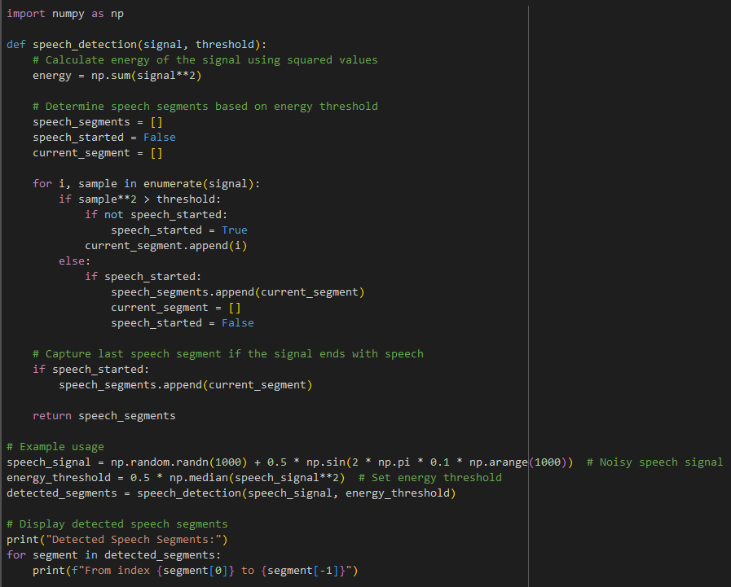
Speech-Background/Slience Discrimination
Implementing Speech-Background/Silence Discrimination

Slide 16
Speech-Background/Slience Discrimination
Summary
Speech Discrimination: Algorithms for discriminating speech from background or silence are fundamental in speech processing applications.
Feature-Based Analysis: Leveraging signal features such as energy, spectral content, and temporal characteristics enables effective discrimination.
Practical Implementation: Python offers tools for implementing speech discrimination algorithms, facilitating accurate speech analysis and processing.

Slide 17
A Bayesian Approach to Voiced Detection

Slide 18
A Bayesian Approach to Voiced Detection
Introduction
Objective: Explore how Bayesian methods can be applied to detect voiced speech segments in speech processing applications.
Motivation
Voiced detection is a critical step in speech processing for speech recognition, speaker diarization, and speech synthesis.
Bayesian inference offers a principled approach to probabilistically model the presence of voiced speech based on observed features.

Slide 19
A Bayesian Approach to Voiced Detection
Importance of Voiced Detection
Why Use Bayesian Voiced Detection?
Signal Segmentation:
Accurate voiced detection enables the segmentation of speech signals into phonetically meaningful units (voiced vs. unvoiced) for further analysis.
Parameter Estimation:
Voiced regions provide essential cues for estimating speech parameters such as pitch, formants, and duration.
Speech Synthesis:
Knowledge of voiced segments is crucial for generating natural-sounding speech with appropriate pitch variations in speech synthesis systems.

Slide 20
A Bayesian Approach to Voiced Detection
Formulation of Bayesian Voiced Detection
Bayesian Framework
Model the probability of a signal segment being voiced or unvoiced using Bayesian inference.
Incorporate prior knowledge (prior probabilities) and likelihoods of observed features given each hypothesis (voiced or unvoiced).
Features Used
Typical features include pitch, energy, harmonics, formants, and spectral characteristics.
These features capture different aspects of the speech signal relevant to voiced detection.
Decision Rule
Apply Bayes' rule to compute posterior probabilities and make decisions based on a threshold or Bayesian classifier.

Slide 21
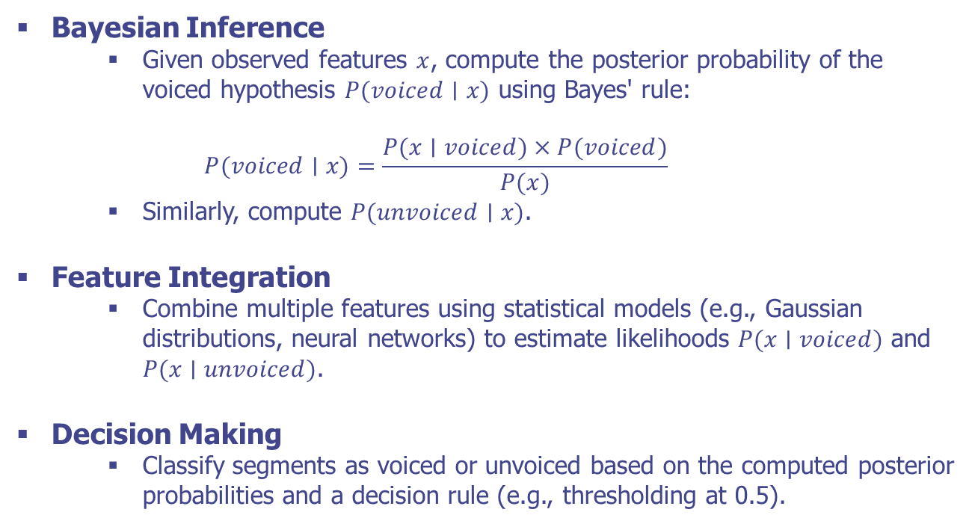
A Bayesian Approach to Voiced Detection
Explanation of Bayesian Voiced Detection
Bayesian Inference
Given observed features $x$, compute the posterior probability of the voiced hypothesis $P(voiced∣x)$ using Bayes' rule:
$$P(voiced∣x)=\frac{P(x∣voiced)×P(voiced)}{P(x)} ​$$
Similarly, compute $P(unvoiced∣x)$.
Feature Integration
Combine multiple features using statistical models (e.g., Gaussian distributions, neural networks) to estimate likelihoods $P(x∣voiced)$ and $P(x∣unvoiced)$.
Decision Making
Classify segments as voiced or unvoiced based on the computed posterior probabilities and a decision rule (e.g., thresholding at 0.5).

Slide 22
A Bayesian Approach to Voiced Detection
Implementing Bayesian Voiced Detection
Objective: Implement a function to perform voiced detection using a Bayesian approach. Develop a Python function to analyze a speech signal and classify segments as voiced or unvoiced based on Bayesian inference.
Steps
Define a function bayesian_voiced_detection(signal, features) that accepts a speech signal array and relevant features.
Compute or extract the required features (e.g., pitch, energy, formants).
Model the likelihood and prior probabilities for voiced and unvoiced segments using Bayesian inference.
Apply a decision rule based on posterior probabilities to classify segments.

Slide 23
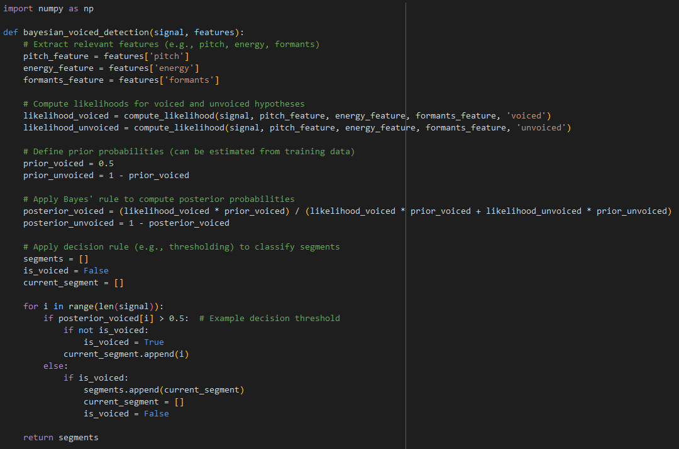
A Bayesian Approach to Voiced Detection
Implementing Bayesian Voiced Detection

Slide 24
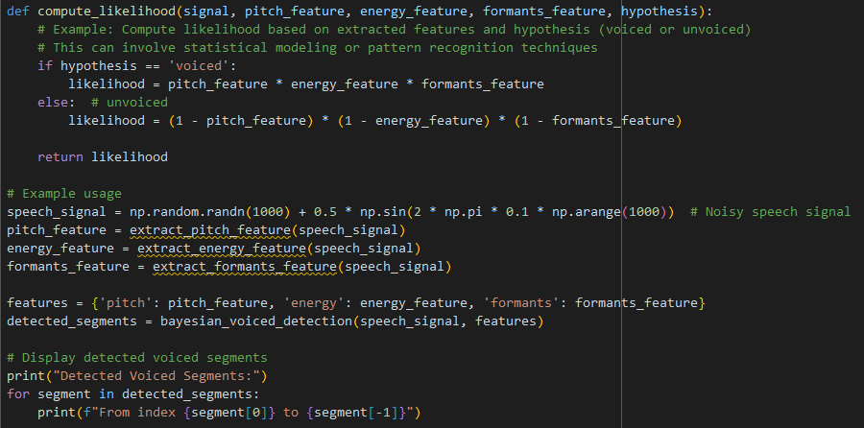
A Bayesian Approach to Voiced Detection
Implementing Bayesian Voiced Detection

Slide 25
A Bayesian Approach to Voiced Detection
Summary
Bayesian Voiced Detection: Bayesian inference offers a principled approach to discriminating voiced speech segments from background or unvoiced segments.
Feature Integration: Integrating multiple speech features within a Bayesian framework enhances the robustness and accuracy of voiced detection algorithms.
Practical Implementation: Python provides versatile tools for implementing Bayesian voiced detection, facilitating advanced speech analysis and processing.

Slide 26
Formant Estimation

Slide 27
Formant Estimation
Introduction
Objective: Formant estimation is a key task in speech signal processing aimed at identifying and quantifying the resonance frequencies of the vocal tract during speech production.
Importance
Formants are spectral peaks in the speech signal that correspond to the resonant frequencies of the vocal tract.
Estimating formants provides critical information about speech sounds, aiding in phonetic analysis, speech synthesis, and speaker recognition.

Slide 28
Formant Estimation
Why Estimate Formants?
Speech Analysis
Formant frequencies convey information about vowel sounds and contribute to distinguishing between different speech sounds (e.g., vowels, consonants).
Analysis of formants helps in understanding the articulatory characteristics of speech.
Speech Synthesis
Formant synthesis techniques use estimated formant frequencies to generate synthetic speech with natural-sounding characteristics.
Formant-based synthesis allows for control over speech parameters like pitch and timbre.
Speaker Recognition
Formant patterns are unique to individuals and can be used as speaker identification and verification system features.

Slide 29
Formant Estimation
Formulation of Formant Estimation
Frequency Analysis:
Formant estimation involves analyzing the spectral characteristics of speech signals to identify formant frequencies.
Modeling Vocal Tract:
The vocal tract is modeled as a linear filter with resonances corresponding to formant frequencies.
Estimation Methods:
Linear Predictive Coding (LPC) models the speech signal and extracts formant frequencies.

Slide 30
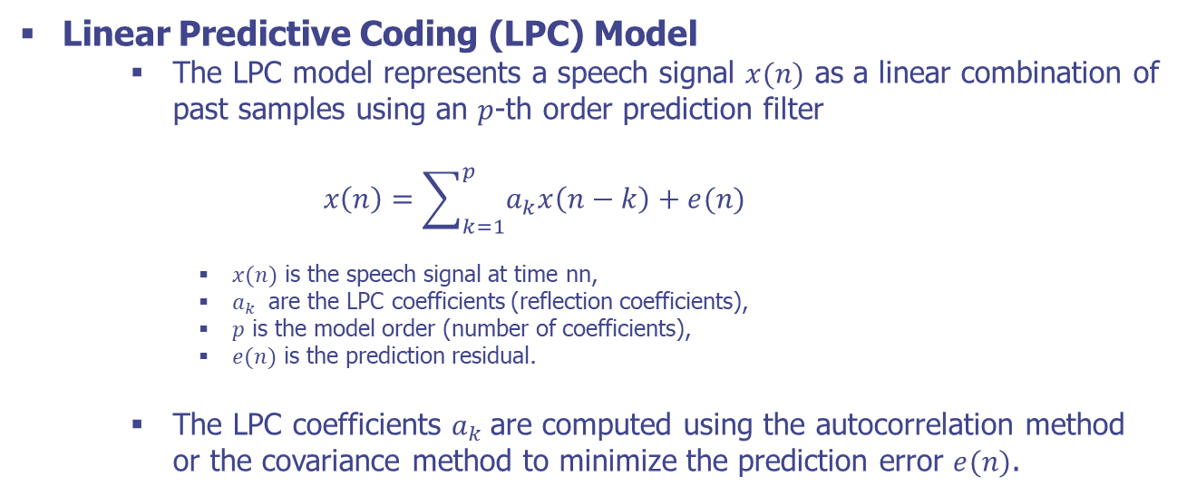
Formant Estimation
Formulation of Formant Estimation
Linear Predictive Coding (LPC) Model
The LPC model represents a speech signal $x(n)$ as a linear combination of past samples using an $p$-th order prediction filter
$$x\left(n\right)=\sum_{k=1}^{p}{a_{k}x\left(n−k\right)+e(n)}$$
$x(n)$ is the speech signal at time nn,
$a_{k}$ are the LPC coefficients (reflection coefficients),
$p$ is the model order (number of coefficients),
$e(n)$ is the prediction residual.
The LPC coefficients $a_{k}$are computed using the autocorrelation method or the covariance method to minimize the prediction error $e(n)$.

Slide 31
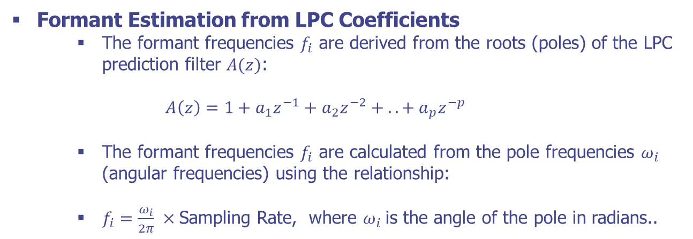
Formant Estimation
Formulation of Formant Estimation
Formant Estimation from LPC Coefficients
The formant frequencies $f_{i}$ are derived from the roots (poles) of the LPC prediction filter $A(z)$:
$$A\left(z\right)=1+a_{1}z^{−1}+a_{2}z^{−2} + ..+ a_{p}z^{−p}$$
The formant frequencies $f_{i}$ are calculated from the pole frequencies $ω_{i}$​ (angular frequencies) using the relationship:
$f_{i}=\frac{ω_{i}}{2π} ×$Sampling Rate, where $ω_{i}$​is the angle of the pole in radians..

Slide 32
Formant Estimation
Explanation of Formant Estimation
Working Principle
Peak Detection
Formants manifest as spectral peaks in the frequency domain representation of speech signals.
Algorithms detect and localize these peaks to estimate formant frequencies.
Model-Based Approach
LPC analysis models the speech signal as a linear combination of past samples, revealing the vocal tract’s filter coefficients.
Formant frequencies are derived from the poles of the LPC filter.
Frequency Domain Analysis
Spectral analysis techniques such as Fast Fourier Transform (FFT) or Linear Prediction help visualize and analyze energy distribution in different frequency bands, highlighting formants.

Slide 33
Formant Estimation
Implementing Formant Estimation
Objective: Develop a function to estimate formants from a given speech signal using LPC analysis. Implement a Python function to estimate formants from a speech signal using LPC analysis.
Steps
Preprocess the speech signal (e.g., apply pre-emphasis, windowing).
Apply LPC analysis to compute linear prediction coefficients.
Convert LPC coefficients to the frequency domain to identify formant frequencies (poles of the LPC filter).
Extract and return the dominant formant frequencies.

Slide 34
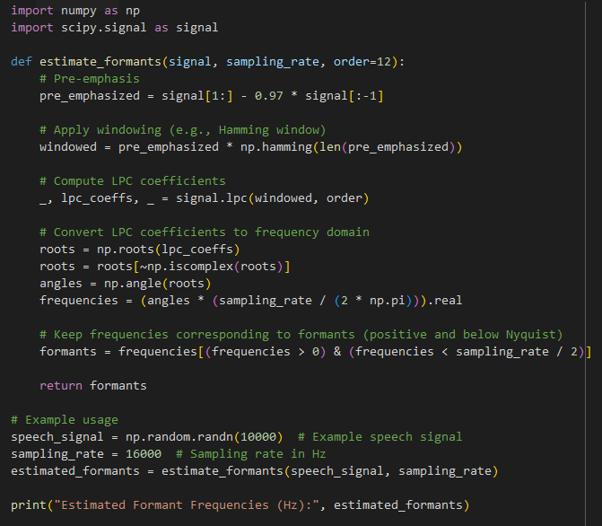
Formant Estimation
Implementing Formant Estimation

Slide 35
Formant Estimation
Summary
Formant Estimation: Estimating formant frequencies is crucial for speech analysis, synthesis, and speaker recognition.
Algorithmic Techniques: Signal processing techniques like LPC analysis are effective for formant estimation.
Practical Implementation: Python provides tools to implement formant estimation algorithms, enabling advanced speech parameter analysis.

Slide 36
Q & A

